Slide 1
Case #1—Stage IIIA NSCLC:
A Multidisciplinary
Treatment Approach
Part III
Suresh Senan, MRCP, FRCR, PhD
VU University Medical Center
Amsterdam, the Netherlands

Slide 2

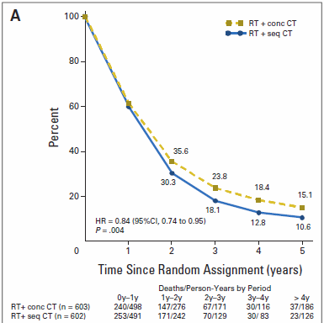
Meta-Analysis of Concurrent vs
Sequential Chemo-RT in Stage III NSCLC
Overall survival
Aupérin A, et al. J Clin Oncol. 2010;28(13):2181-2190.

Slide 3
Concurrent Chemo-RT Is Standard of
Care in Fit Patients With a Stage III NSCLC [Level 1 Evidence]
INT 0139 (Albain K, 2009)
  Median overall survival: 22.2 months (chemo-RT arm)
RTOG 94-10 (Curran W, 2011)
  Median overall survival 17 months
  (2-Dimensional radiotherapy)
RTOG 0617 (Bradley J, 2015)
  Median overall survival 28.7 months (standard-dose 60 Gy) and 20.3 months (74 Gy) after high-dose radiotherapy (use of 3-Dimensional radiotherapy mandatory)
Albain KS, et al. Lancet. 2009;374(9687):379-386. Curran WJ Jr, et al. J Natl Cancer Inst. 2011;103(19):1452-1460. Bradley JD, et al. Lancet Oncol. 2015;16(2):187-199.

Slide 4

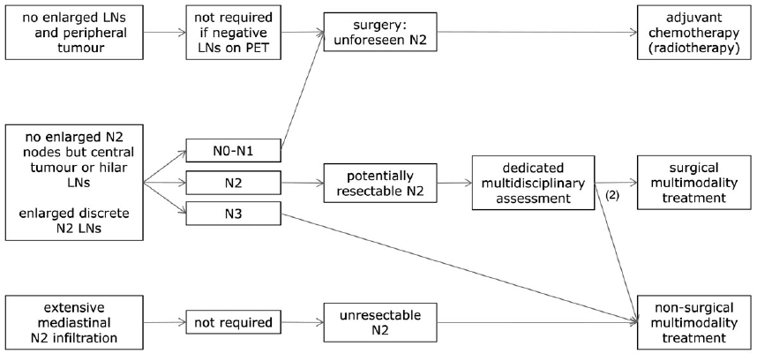
Stage III NSCLC: Guidelines
For resectable LA-NSCLC, especially single nodal stage N2 disease, both definitive chemoradiotherapy and induction therapy followed by surgery are options [level II, A]
Surgery is preferably considered in patients in whom a complete resection by lobectomy is expected. [level II, B] More complex surgical resections after induction treatment should be carried out in experienced centers [level III, B]
Vansteenkiste J, et al. ESMO Clinical Practice Guidelines, Ann Oncol. 2013;24 Suppl 6:vi89-vi98.

Slide 5
Combined-Modality Trials With Surgery
Trial | Inclusion | Study Question | N | Answer | Post-Therapy 30-Day Mortality | 5-Year Survival*
EORTC 08941¹ | Unresectable IIIA/N2 | CT-S vs CT-RT | 579 | NO difference | 4% NR | 16% 14%
INT 0139² | Potentially resectable IIIA/N2 | CRT-S vs CRT | 429 | NO difference | 8% 2% | 27% 20%
ESPATUE³ | IIIA/N2 and IIIB | CT-CRT-S vs CT-CRT-CRTb | 246 | NO difference | 6% 3% | 44% 41%
SAKK 16/00⁴ | Potentially resectable IIIA/N2 | CT-RT-S vs CT-S | 232 | NO difference | 0% 3% | 40% 34%
CT, induction chemotherapy; RT, radiotherapy; S, surgery; CRT, concurrent chemoradiotherapy; CRTb, concurrent chemoradiotherapy boost
1. Van Meerbeeck J, et al. J Natl Cancer Inst. 2007;99(6):442-450; 2. Albain KS, et al. Lancet. 2009;374(9687):370-386. 3. Eberhardt W, et al. J Clin Oncol. 2014;32(5s): Abstract 7510. 4. Pless M, et al. Ann Oncol. 2014;25(Suppl 4): Abstract 1195O.

Slide 6
Combined-Modality With Surgery
Concurrent chemo-RT increases likelihood
of downstaging nodal disease¹
Most patients who are candidates for trimodality (chemo-RT-surgery) finally
do not undergo surgery¹
Introducing a gap during preoperative concurrent chemo-RT for preoperative restaging decreases the effectiveness of a standard treatment (concurrent chemo-RT)
1. Cerfolio RJ, et al. Ann Thorac Surg. 2008;86(3):912-920.

Slide 7
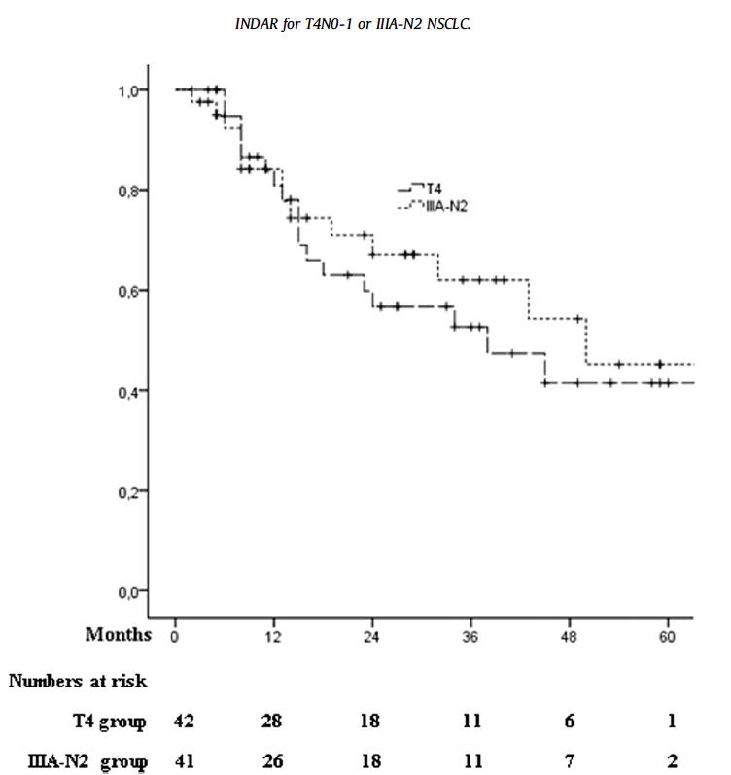
CT-RT Results in Single Station IIIA-N2
83 patients included in 2 prospective trials
Stage T4N0-1 or IIIA-N2 with 1 pathologic nodal station, treated with CT-RT with concurrent or sequential platinum-based chemotherapy
Median OS = 24 months
5 year OS = 24%
Reymen B, et al. Radiother Oncol. 2014;110(3):482-487.

Slide 8
Which treatment strategy would you recommend if the same patient were to have multiple sites N2 disease (size of the lymph nodes 1.5-3.5 cm)?
Neoadjuvant chemo → surgery
(if PET/CT restaging = N0-1) +/- radiotherapy (RT)
Induction concurrent CRT (45-50 Gy) → surgery
Definitive concurrent CRT (60-74 Gy)
Definitive concurrent CRT → consolidation chemotherapy
Induction chemotherapy → concurrent CRT

Slide 9
Which Dose of Radiotherapy?
RTOG 0617: Dose of 74 Gy (37 fractions) was inferior compared to 60 Gy (in 30 fractions)
Use of 60 Gy versus ‘intermediate high doses’ of 60-74 Gy: Analysis in 1274 patients found similar OS between 2 propensity score balanced groups
Bradley JD, et al. Lancet Oncol. 2015;16(2):187-199. Rodrigues G, et al. Int J Radiat Oncol Bios Phys. 2015; 91(1):133-139

Slide 10
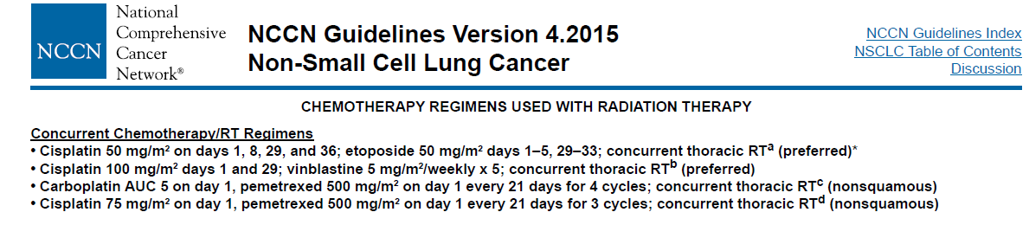
Which Chemotherapy in Chemo-RT?
NCCN guidelines (v 4.2015): “This regimen can be used as neoadjuvant chemotherapy
Cisplatin-etoposide is the preferred regimen. If weekly carboplatin and pacitaxel is used because the patient is not able to tolerate concurrent full-dose cisplatin-radiotherapy, the treating physician should consider 2 cycles of full-dose platinum therapy after local treatment is completed”
National Comprehensive Cancer Network. Available at: www.nccn.org/professionals/physician_gls/pdf/nscl.pdf. Accessed 12 March 2015.

Slide 11
Cisplatin or Carboplatin-Based Chemo-RT
SEER-Medicare registry, 1878 patients >65 years of age with unresected stage III NSCLC that received concurrent CRT (2002-2009)
Carboplatin-based CRT was associated with similar long-term survival but lower rates of toxicity
Adjusted rates of neutropenia, anemia, and thrombocytopenia lower among carboplatin-treated patients
Ezer N, et al. Radiother Oncol. 2014;112(2):272-278.

Slide 12
Cisplatin or Carboplatin-Based Chemo-RT
Veterans Health Administration 1842 patients treated with concurrent radiotherapy with EP or CP from 2001-2010
EP used in 27% (n=499) and not associated with a survival advantage
Treatment with EP associated with more hospitalizations, infections, acute kidney disease/dehydration
EP, etoposide + cisplatin; CP, carboplatin + paclitaxel
Santana-Davilia R, et al. J Clin Oncol. 2015;33(6):567-574.

Slide 13
Symptomatic Radiation
Pneumonitis (RP): A Meta-Analysis
Individual patient meta-analysis in 836 patients treated with concurrent chemo-RT; median dose 60 Gy; median
follow-up 2.3 years
Cisplatin/etoposide (38%), carboplatin/paclitaxel (26%)
Overall rate of RP 30% (n = 249), fatal RP in 1.9% (n = 16)
Multivariable analysis of factors predictive of symptomatic radiation pneumonitis in the validation dataset (n = 279)
 | Multivariable Analysis
Factor | OR | 95% CI | P Value
Age (per 10-year increase) | 1.38 | 0.95-2.01 | .089
Chemotherapy regimen |  |  | <.001
Cisplatin-etoposide | 1 | Reference
Carboplatin-paclitaxel | 5.52 | 2.25-13.55
Other | 3.39 | 1.50-7.68
Volume of lung receiving ≥20 Gy (V₂₀) | 1.07 | 1.03-1.11 | <.001
Palma DA, et al. Int J Radiat Oncol Biol Phys. 2012;85(2):444-450.
Notes:
Welkom in VUmc

Slide 14
Consolidation Chemotherapy
is Unproven in LA-NSCLC
Pooled analysis of 41 studies, including 7 phase III studies and 34 phase II studies with 45 arms (consolidation chemotherapy, CCT+: 25; CCT−: 20)
Comparable for clinical stage, PS, histology, sex, and median age between the two groups
No statistical difference in pooled mOS between CCT+ (19.0 month; 95% CI, 17.3-21.0) and CCT− (17.9 month; 95% CI, 16.1-19.9). No differences in grade 3-5 toxicities in pneumonitis, esophagitis, and neutropenia
Addition of CCT did not lead to significant survival prolongation or risk reduction in death
Tsujino K, et al. J Thorac Oncol. 2013;8(9):1181-1189.

Slide 15
PROCLAIM Trial: Stage III
NSCLC (Closed)
CONCURRENT
CONSOLIDATION
Pemetrexed: (500 mg/m²), IV on D1, 22 and 43
Cisplatin: (75 mg/m²) iv after Pem on D1, 22 and 43
TRT: 66 Gy in 33 fx (daily 2 Gy fx; Mon-Fri) 3 cycles, vitamins, dexamethasone
Pemetrexed: 500 mg/m², IV on D1 every 21 days x 4 cycles, vitamins, dexamethasone
RANDOMIZE
Arm A
Dealer’s choice: 2 cycles of
1. Etoposide 50 mg/m² days 1-5 and 29-33 and cisplatin 50 mg/m² days 1, 8, 29, and 36
2. Paclitaxel 200 mg/m² and carboplatin AUC = 6 both on days 1 and 22
3. Vinorelbine 30 mg/m² days 1, 8, 22 and 29 and cisplatin 75 mg/m² days 1 and 22
3-5 weeks
Etoposide: (50 mg/m²) IV on D1-D5, D29-D33
Cisplatin: (50 mg/m²) IV after etoposide on D1, 8, 29, 36
TRT: 66 Gy in 33 fx (daily 2 Gy fx; Mon-Fri) 2 cycles
Arm B
Chemo to commence with the first day of RT
ClinicalTrials.gov: Identifier: NCT00686959

Slide 16
Targeted Therapy and Radiotherapy in Stage III NSCLC

Slide 17
Phase III Trials Evaluating EGFR Inhibitors
SWOG 0023¹: Following concurrent chemo-RT,
gefitinib led to decreased survival as a result of
tumor progression, and not gefitinib toxicity; unselected population
RTOG 0617 trial²: Standard-dose vs high-dose chemo-RT
paclitaxel-carboplatin ± cetuximab; use of cetuximab was associated with a higher rate of grade 3 or worse toxic effects (205 [86%] of 237 vs 160 [70%] of 228 patients; P<.0001).
1. Kelly K, et al. J Clin Oncol. 2008;26(15):2450-2456. 2. Bradley JD, et al. Lancet Oncol. 2015;16(2):187-199.

Slide 18
How Would I Treat This Patient?
Definitive concurrent CRT (66 Gy)
  Cisplatin/etoposide regimen
    “EP 50/50” regimen
    3 weekly cisplatin 75 mg/m² with
    etoposide 120 mg/m² days 1-3

